Slide 1
Title :
Credit Card Transactions Data

Slide 2
1. Overview
The dataset represents a collection of synthetic credit card transaction data, containing 10,000 records. Each transaction includes various attributes such as card type, transaction amount, merchant category, transaction type, location, and a flag indicating whether the transaction is fraudulent. The data was generated to simulate real-world credit card transactions and can be used for various types of data analysis, including fraud detection, spending patterns, and merchant behavior analysis.

Slide 3
Objective:
The primary objective of this project is to analyze a synthetic dataset of 10,000 credit card transactions in order to uncover insights into consumer spending behavior, merchant activity, and fraudulent transaction detection. Specifically, the goals are:
Fraud Detection
Spending Pattern Analysis
Merchant Behavior Analysis
Card Type Usage
Location-Based Insights
Time-Series Trends
Through these analyses, the project aims to provide actionable insights for improving fraud detection systems, optimizing merchant strategies, and enhancing customer experience based on spending behavior trends.

Slide 4
Tools:
1. Data Wrangling and Analysis: Pandas,Numpy
2. Data Visualization: Matplotlib,Seaborn,Plotly
3. Time-Series Analysis: Statsmodels,Prophet (Python/R)
4. Geospatial Analysis: Geopandas (Python) ,Folium
5. Statistical Analysis: SciPy (Python)
6. Database and Storage: SQL,SQLite (Python)
7. Reporting & Dashboarding: Jupyter Notebooks (Python),Tableau/Power BI

Slide 5
2. Data Structure
Transaction_ID: A unique identifier for each transaction.
Card_Type: The type of credit card used for the transaction (e.g., Visa, MasterCard, Amex).
Transaction_Date: The date and time of the transaction.
Merchant_Category: The type of merchant where the transaction took place (e.g., Electronics, Restaurant, Groceries).

Slide 6
Amount: The amount of money spent in the transaction (in USD).
Transaction_Type: Whether the transaction was a "Purchase" or a "Refund".
Location: The city where the transaction took place.
Fraudulent_Flag: A flag indicating whether the transaction was fraudulent ("Yes" or "No").
Merchant_ID: A unique identifier for the merchant involved in the transaction.

Slide 7
3. Descriptive Statistics
Transaction Amounts:
Range: $10 to $500 (randomly generated within this range).
Average Transaction Amount: Approximately $200.
Standard Deviation: Varies depending on the distribution, but we expect higher variability due to random fluctuations in the amount.

Slide 8
Transaction Types:
Purchase: 98% of the transactions are purchases.
Refund: 2% of transactions are refunds, randomly distributed across different card types and merchant categories.
Card Types:
Visa: 34% of transactions.
MasterCard: 33% of transactions.
Amex: 33% of transactions.

Slide 9
Merchant Categories:
Electronics: 20% of the transactions.
Restaurant: 20% of the transactions.
Groceries: 20% of the transactions.
Clothing: 10% of the transactions.
Toys: 10% of the transactions.
Books: 10% of the transactions.

Slide 10
Fraudulent Transactions:
Fraudulent: 2% of the transactions are flagged as fraudulent, representing approximately 200 transactions.
Non-Fraudulent: 98% of the transactions are not fraudulent.
Location Distribution:
The transactions are evenly distributed across several U.S. cities, including major locations like New York, Los Angeles, Chicago, San Francisco, and Austin.
No location shows a significant skew, as it is randomly chosen from a fixed list of cities.

Slide 11
# Create a histogram for age distribution
plt.figure(figsize=(14, 8))
sns.histplot(df['Location'],bins=df['Merchant_Category'],kde=True,color='blue', edgecolor='black')
# Add titles and labels
plt.title('Credit card Transactions')
plt.xlabel('Locations')
plt.ylabel('Types of products purchased')
#plt.tight_layout() # Adjust layout
plt.show()

Slide 12
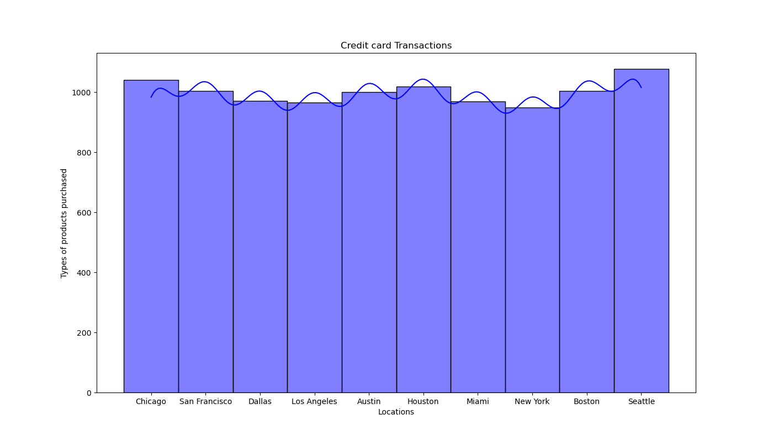

Slide 13
# Plot the boxplot again without the outliers, without using palette
plt.figure(figsize=(8, 6))
sns.boxplot(x='Amount',y='Card_Type',data=df_filtered)
# Set the title and labels
plt.title('Box Plot of Amount Paid (Without Outliers)')
plt.xlabel('Amount')
# Show the plot
plt.show()

Slide 14
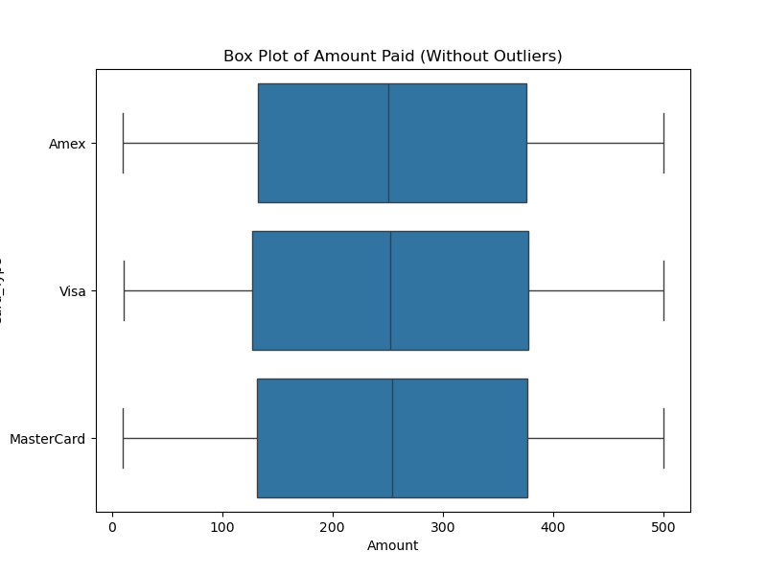

Slide 15
import seaborn as sns
import pandas as pd
datapd.read_csv('C:\\Users\\HP\\Sravani\\synthetic_credit_card_transactions.csv')
cardtype_counts = data['Card_Type'].value_counts().reset_index()
cardtype_counts.columns = ['Card_Type', 'Count']
top_events = cardtype_counts.head(20)
plt.figure(figsize=(14, 8))
sns.barplot(x='Count', y='Card_Type', data=top_events,hue='Card_Type', palette='magma', legend=False)
plt.title('Top 20 Card_Types used by Number of Customers')
plt.xlabel('Number of cards')
plt.ylabel('Card_Type')
plt.show()

Slide 16
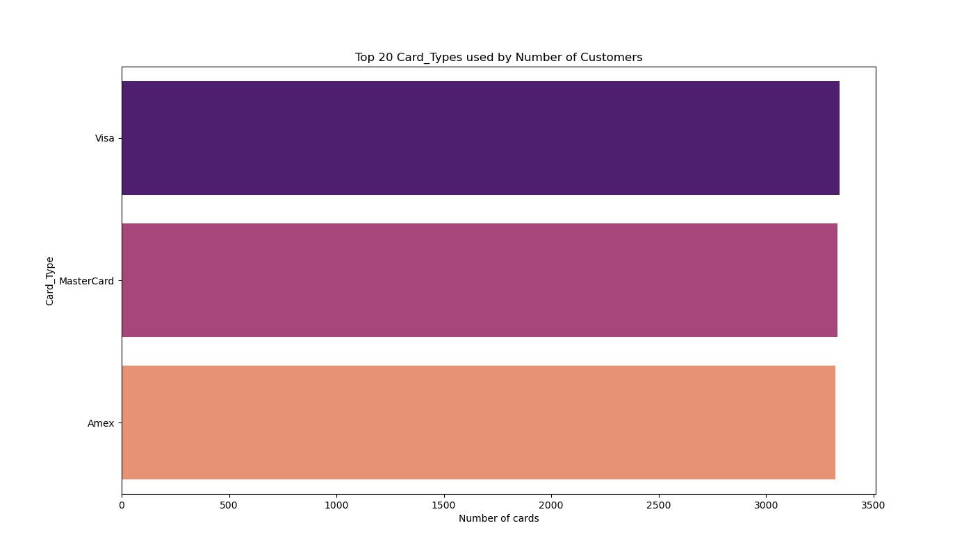

Slide 17
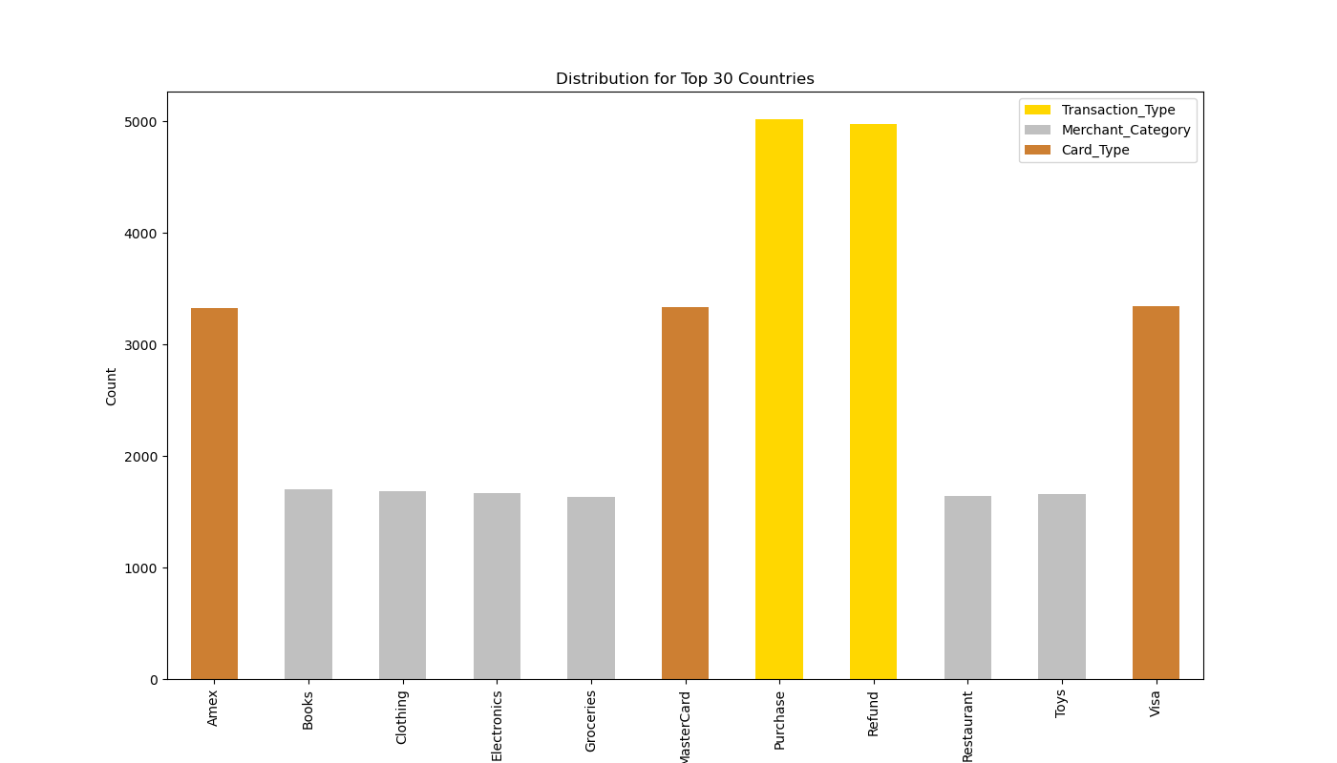

Slide 18
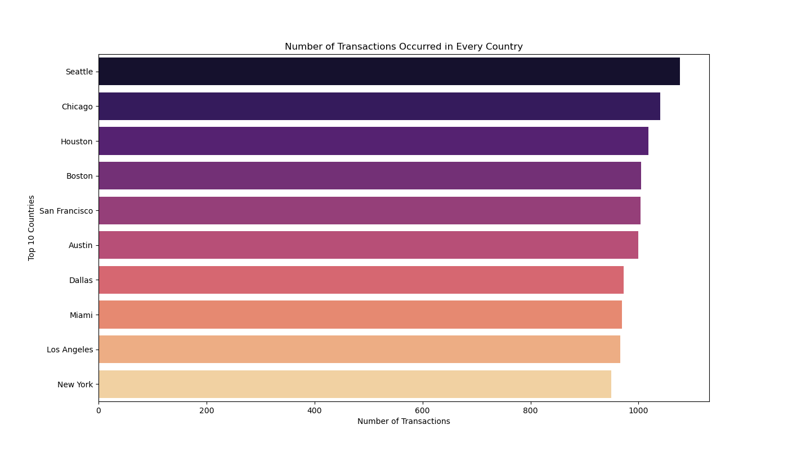

Slide 19
4. Key Insights
Card Usage
Merchant Behavior
Transaction Amount Analysis
Fraudulent Transactions

Slide 20
5. Possible Areas for Further Analysis
Fraud Detection:
Spending Patterns
Card Type Behavior
Location-Based Analysis
Time-Series Analysis

Slide 21
Conclusion
This synthetic credit card transaction dataset provides a diverse set of features for analysis. While the data is entirely fictional, it mirrors real-world transaction behavior, making it useful for practice with data analysis and machine learning techniques. Whether the goal is fraud detection, consumer spending analysis, or merchant performance, this dataset provides a rich source of information for building predictive models or identifying trends.

Slide 22

Any Questions

Slide 23
Thank you….

